Slide 1



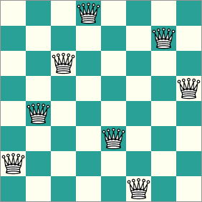
Introduction to Computation
Autumn, 2023
Prof. Fan Cheng
Shanghai Jiao Tong University
chengfan85@gmail.com
https://github.com/ichengfan/itc

Slide 2
Outline
Tuple
Dict
String
Set
Summary
6

Slide 3
Tuple

Slide 4
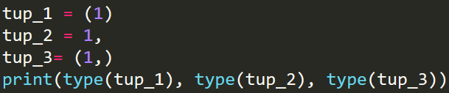
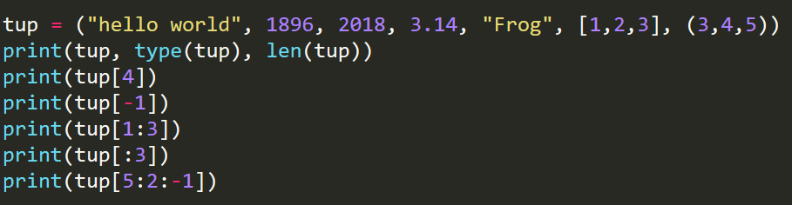
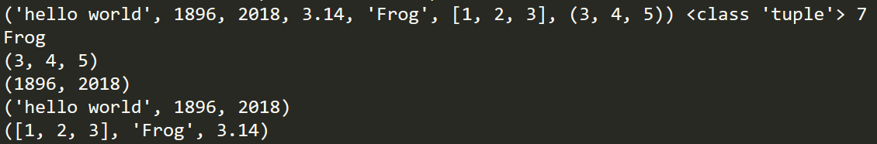



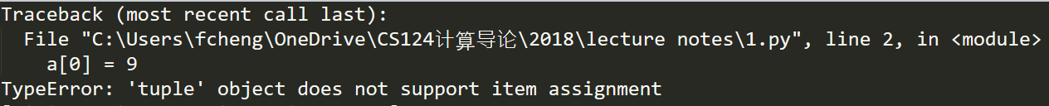

Tuple (元组)
Tuples are written with round brackets () (could be omitted)
tup = (element1, elmement2, …, )
tuple() method will make a tuple (similar to list()) (tuple类型的构造函数)
To create a tuple with a single element, we need to add a “,” at the end
tup = (element1,)
Tuple is ordered (顺序排列) and immutable (不可变).
len(), type(), [], in, not in, for
You cannot modify a tuple, which is a grammar error(不可对元组中元素单独修改)
元组：不可修改的list

Slide 5
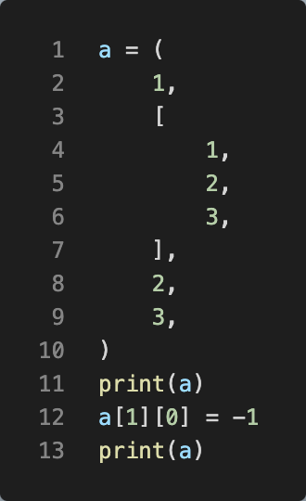
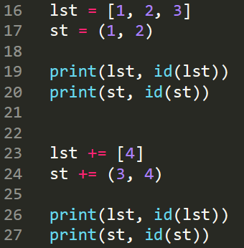
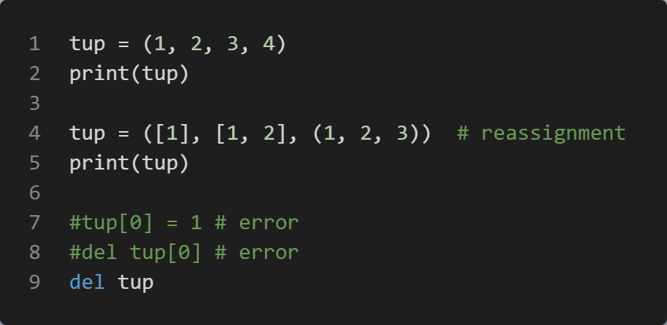
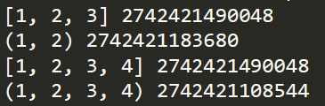



Immutable and Mutable
元组元素的元素可以被修改
Tuple is immutable. The elements of tuples could be mutable
Immutable: cannot appear at the left side of “=”
Reassignment is allowed
del an element is not allowed, but del the whole tuple is allowed（只能删除元组全体，不能单独删除元素）
list是直接修改，tuple是创新
重新赋值

Slide 6


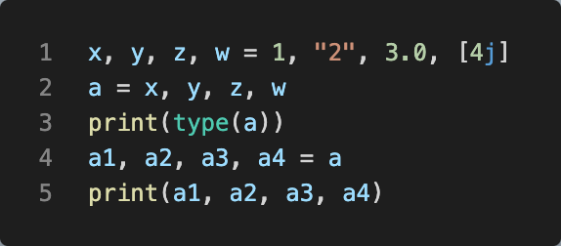


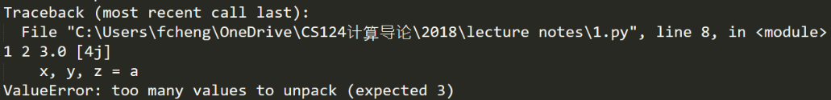
Tuple: packing and unpacking
Packing: serval variables can be grouped into a tuple
x = a, b, c, d # x will be a tuple with four elements
Unpacking: a tuple can be broken up into several elements
x1, x2, x3, x4 = x # Then x1 = a, x2=b, x3 =c, x4 =d
The left and right should have the same number of elements
Unpacking and packing 可以嵌套
((a, b), c) = ((1, 2), 3)
Simultaneous assignment is based on Tuple：
x1, x2, x3, x4 = a, b, c, d
元组：函数中同时return 多个值

Slide 7
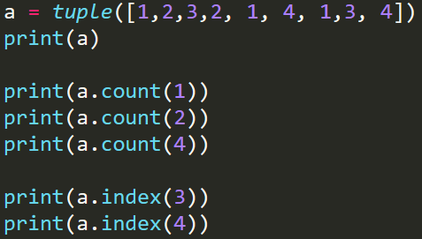
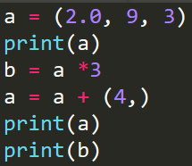
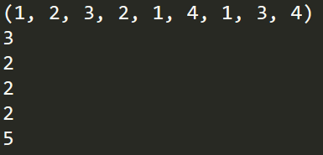


Tuple: immutable list
tuple_a.count(x): Returns the number of times a specified value occurs in a tuple
tuple_a.index(x): Searches the tuple for a specified value and returns the position of where it was found
When x is not in tuple_a, an error will arise
[], [::], +, *
元组：不可修改的list

Slide 8
Quick test
a=1与a=(1,)的差异
Tuple不可修改，list可修改

Slide 9
Dict

Slide 10
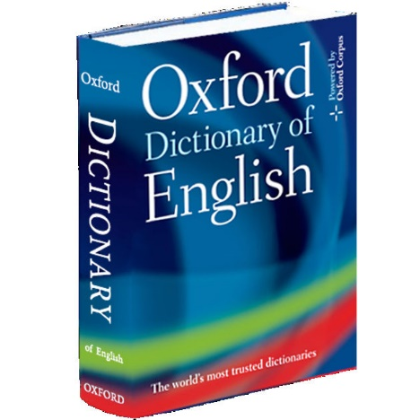
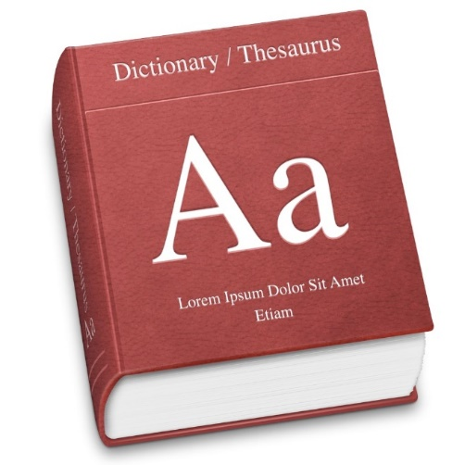
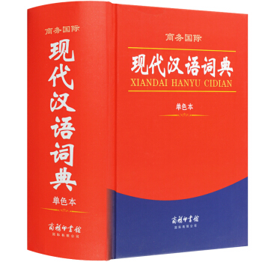
Dictionary
List search: Search from the first item to the last
Dictionary search: We use keywords to search the dictionary, not a list search
“University” U-N-I-V-E-R-S-I-T-Y. We won’t search the whole dictionary
In Python Dict, we use keys to index values; it is unordered, not an ordered list
Dict: Words and their interpretations
Word -- Key(关键字)
Interpretation – Value(值)
Dict is more efficient than list

Slide 11
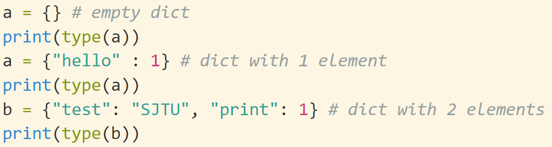


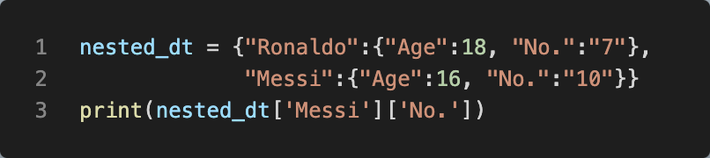

Dict: Creation
The elements of dict should be a pair -- key: value. “林则徐”: “民族英雄”. All the pairs are enclosed by {}
The key should be only immutable type. 关键字是唯一的且immutable. List type (mutable) cannot be the key
Values can be any type. Nested dict.value 可以是dic
len(dict) returns the length of dict

Slide 12
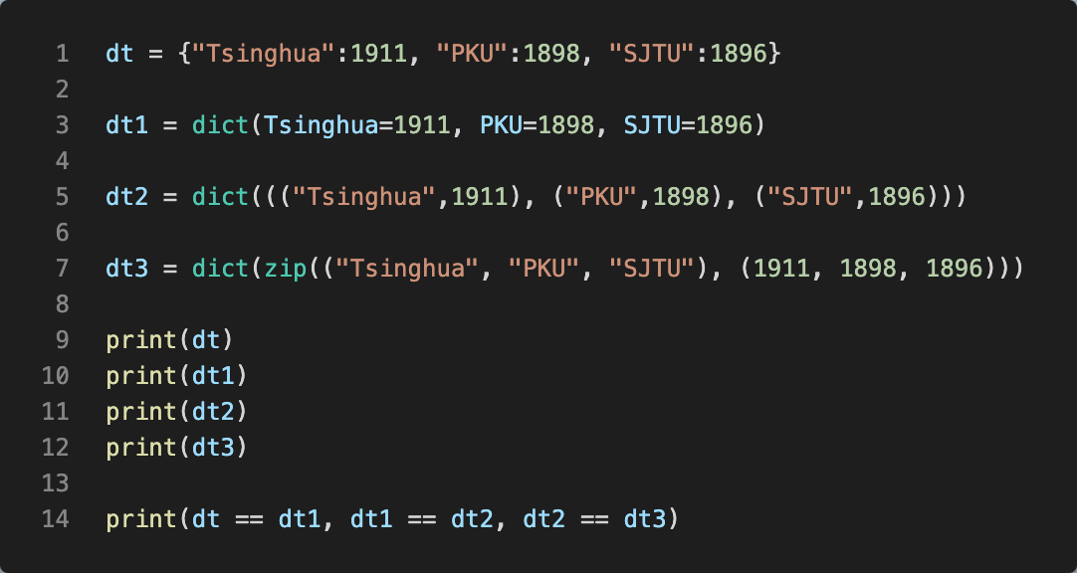
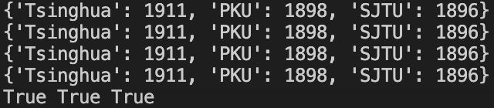
dict()
三种构造方式：
dict类的构造函数
class dict(**kwarg)
class dict(mapping, **kwarg)
class dict(iterable, **kwarg) (dt = dict({}))

Slide 13
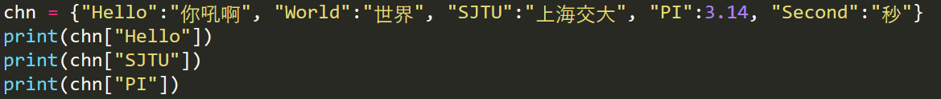


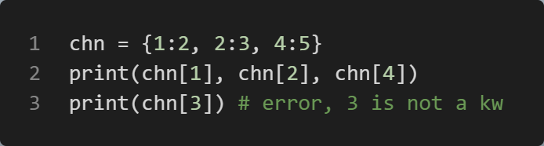
Dict: []
字典不能通过序号访问元素
Values of a dictionary can be accessed via dict[key]. If the key is not existed in the dict, an error will arise
Suppose we have a dict as follows:
chn = {"Hello":"你吼啊", "World":"世界", "SJTU":"上海交大", "PI":3.14, "Second":"秒"}
All its keys are: “Hello”, “World”, “SJTU”, “PI”, “Second”
An error will arise if you use other values to access the chn
Unless the index is a keyword, dict cannot be accessed by an index (KeyError)
In principle, there is no order on the keys, unless you specify it. For example: a = {"test":1, 1.2:3, 3:"hello", 5:[1,2,3]}

Slide 14
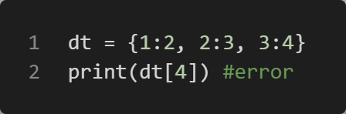
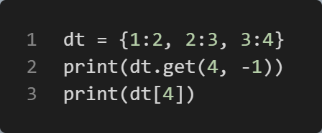
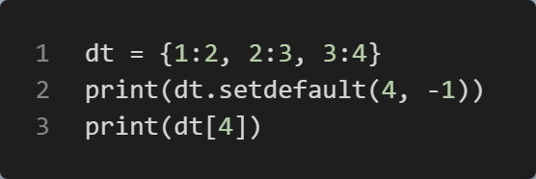

get() and setdefault()
如果我们尝试访问字典中不存在的键值，Python 将返回 KeyError。为了解决这个问题，我们可以使用 get（） 方法，如果它的键在字典中，它将返回该值，或者它将返回我们设置的一些默认值setdefault（） 中。setdefault（） 方法经常与 get（） 方法混淆。它们执行或多或少相同的任务。事实上，如果我们怀疑字典中不存在一个键，我们可以使用此方法返回默认值。但是，与 get（） 相反，此方法在字典中插入此键的默认值
If we try to access a value of the key that doesn't exist in the dictionary, Python will return a KeyError.
To get around this problem, we can use the get() method that will return the value if its key is in the dictionary, or it will return some default value that we set
setdefault(). The setdefault() method is often confused with the get() method. They perform more or less the same task. Indeed, if we suspect that there is a non-existing key in the dictionary, we can use this method to return a default value. However, in contrast to get(), this method inserts the default value of this key in the dictionary
这里还是会报错，因为get没有在字典中添加元素，但如果用setdefault代替get则可用dt[4]检索了

Slide 15
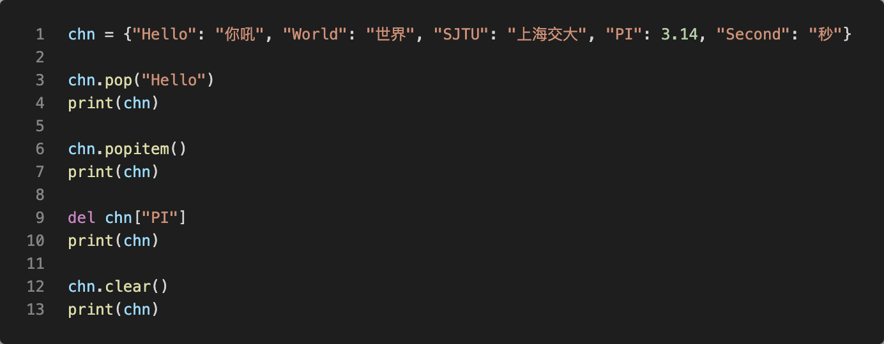
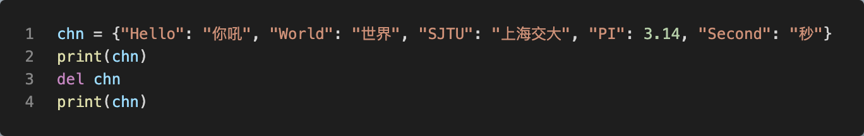
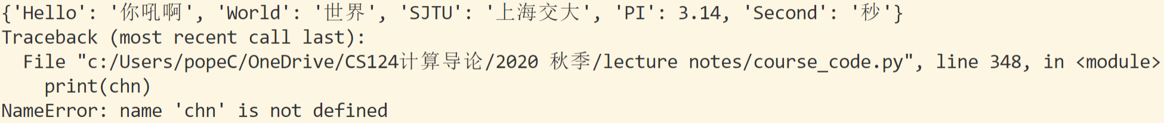
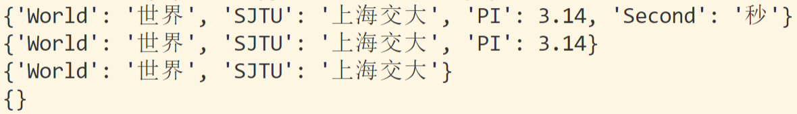
Dict: Removing Items
delete dict[key]: The del keyword removes the item with the specified key name. The del keyword can also delete the dictionary completely
Dict.clear(): make an empty dict
dict.pop(key): The pop(key) method removes the item with the specified key name
dict.popitem(): The popitem() method removes the last inserted item (in versions before 3.7, a random item is removed instead ☺

Slide 16
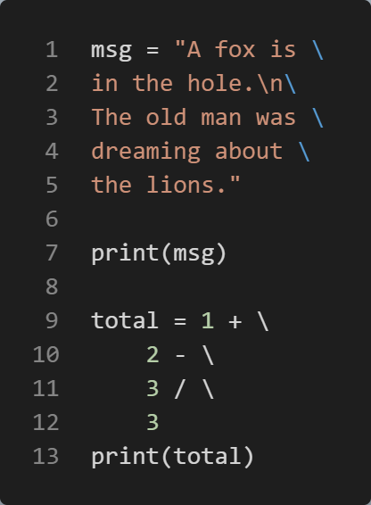
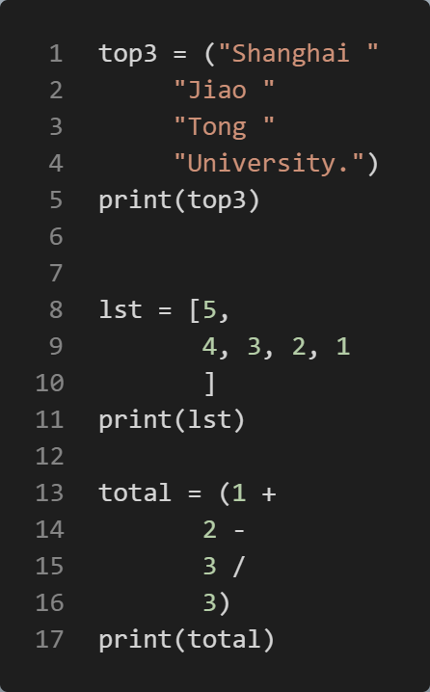
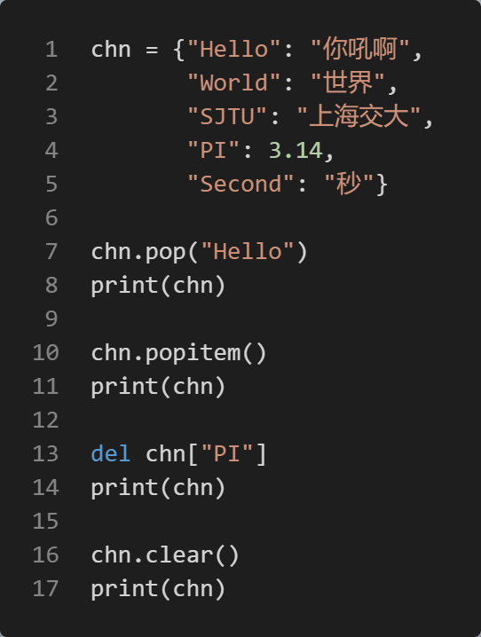


Multi-Line Statements
Explicit line continuation: \, use the line continuation character (\) to split a statement into multiple lines
Implicit line continuation: Implicit line continuation is used when you split a statement using either parenthesis ( ), brackets [ ], and braces { }
\后面不能有空格(转义字符)

Slide 17
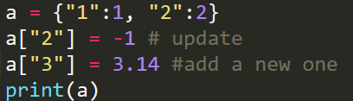


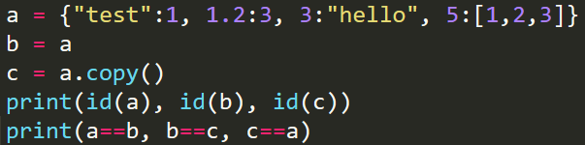

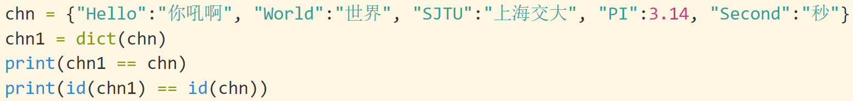

Dict: modification, copy and merge
a = {1:2, 2:3, 3:4}
b = a
c = a.copy()
b[1] = 0
c[2] = 5
print(a)
print(b)
print(c)
#a,b一起改变，与c互不影响
The values can be reassigned/updated/added via its key
The dictionary in python is mutable. You need to make a copy in case of modification: dict.copy()
It is also possible to use the dict() constructor to make a new dictionary
b is the alias of a; c is a copy of a

Slide 18
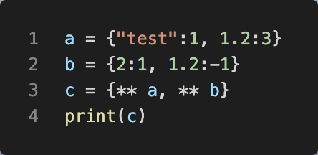
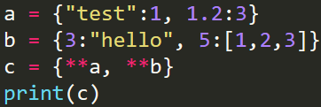
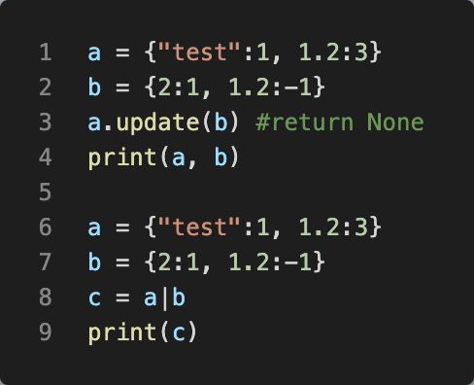
Merge: **, |, update()
Merge two dictionaries x and y, z = {**x, **y}(合并字典)
dta.update(dtb): return None, update dta in place
dta | dtb
修改a而不是重新赋值
生成新的字典
相同的key，后面会取代前面（{**x,**y}中y会取代x）

Slide 19
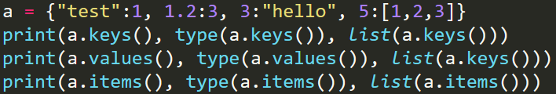
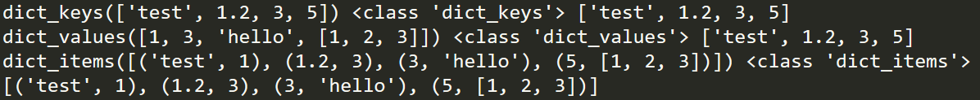


Keys(), values(), items()
For a dictionary dict, there are several methods to get its useful information:
dict.keys(), returns all its keys
dict.values(), returns all its values
dict.items(), returns all its items (key: value pairs)
dict.keys(), dict.values(), and dict.items() will not directly return a list. You should transform yourself.（不会直接返回列表）
in and not in are used to test the membership
判断key在不在里面

Slide 20
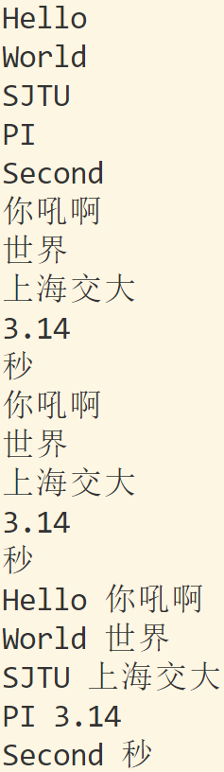
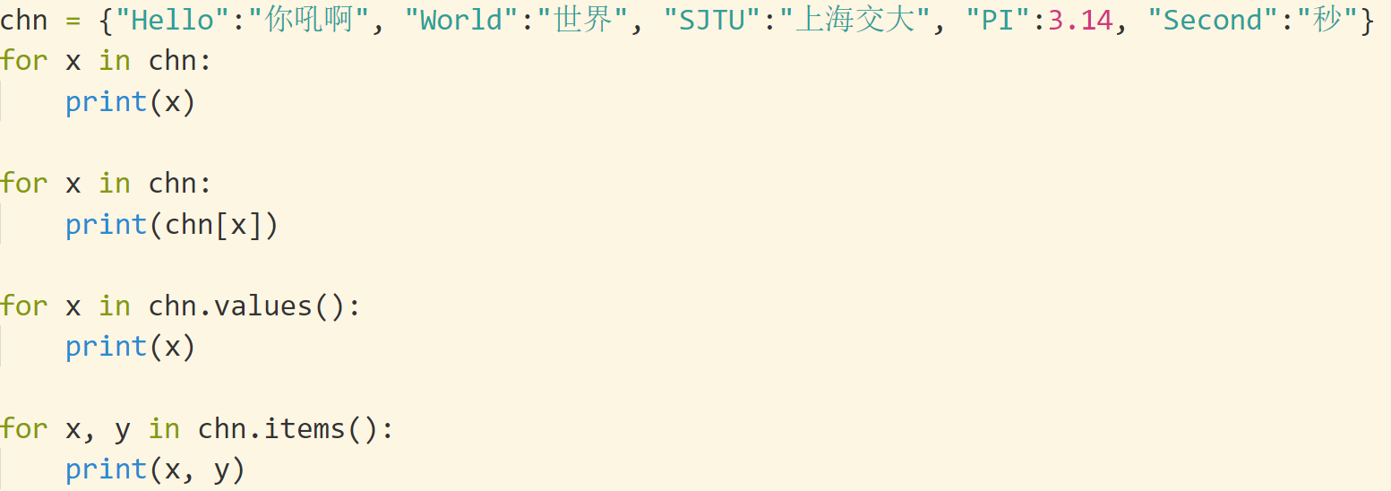
Loop Through a Dictionary
Print all key names in the dictionary, one by one:
for x in dict: print(x)
Print all values in the dictionary, one by one:
for x in dict: print(dict[x])
You can also use the values() method to return values of a dictionary:
for x in thisdict.values(): print(x)
Loop through both keys and values, by using the items() method:
for x in thisdict.items(): print(x, y)

Slide 21
Dictionary Methods
Python has a set of built-in methods that you can use on dictionaries.
Method | Description
clear() | Removes all the elements from the dictionary
copy() | Returns a copy of the dictionary
fromkeys() | Returns a dictionary with the specified keys and value
get() | Returns the value of the specified key
items() | Returns all the tuples for each key value pair
keys() | Returns all the dictionary's keys
pop() | Removes the element with the specified key
popitem() | Removes the last inserted key-value pair
setdefault() | Returns the value of the specified key. If the key does not exist: insert the key, with the specified value
update() | Updates the dictionary with the specified key-value pairs
values() | Returns all the values in the dictionary

Slide 22
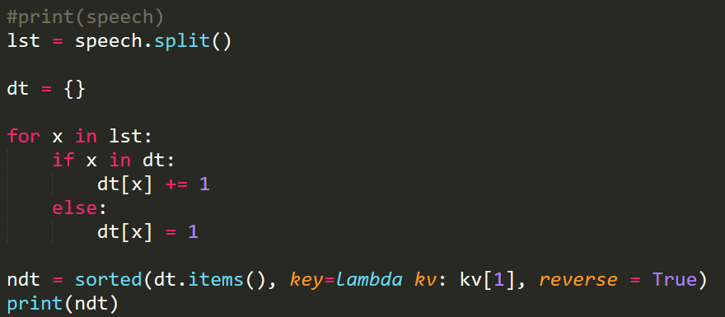
Dict应用：统计数量
Dict的结构中key: value, 其中value可用来保存有用的信息，譬如数量
给定一篇文章，统计每个单词出现的数量 https://www.abrahamlincolnonline.org/lincoln/speeches/gettysburg.htm (葛底斯堡演说)
speech = '''
Four score and seven years ago our fathers brought forth on this continent, a new nation, conceived in Liberty, and dedicated to the proposition that all men are created equal.
…
'''
分解为一个个单词
dict查找、插入、删除比list快很多

Slide 23
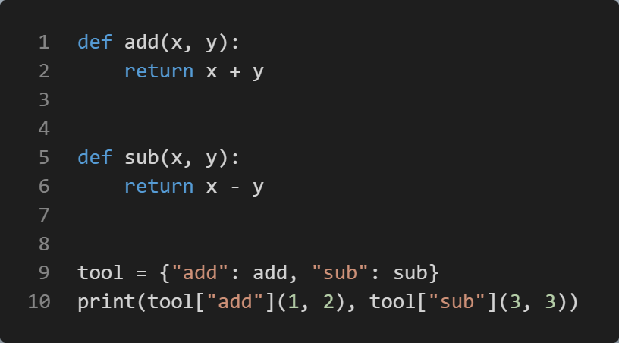
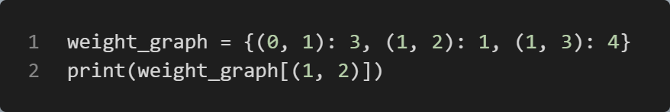


Dict: more examples
字典是跳着搜索的，这和列表不同。
Replace conditional expression
Graph theory: weighted graph
1
0
3
2
3
4
1
比if-elif-else更清晰,配合$λ$表达式

Slide 24

String

Slide 25
String: Review of Lecture 3
String can be defined by “…”, ’…’, and “““…”””. str(). Escape character: “\n”, “\t”
input(): always returns a string
String is an immutable list. You cannot change a string. Yet you can reassign or create it
[]: String can be accessed by str[i](str[i] = “a” #error)
str[start: stop: step]: The rule for a slice of the string are the same with list and tuple
len(str), returns the length of a string
+: str1 + str2, returns the concatenation of two strings
*: str*n, repeats the string n times (What if 𝑛≤0?)
Loop: for x in str1: do_sth()
Alphabetical order : >, <, >=, <=, !=, ==
String format
C-style
“{}. ..{}”.format(x, y)
F-string: f“{x}…{y}”
每一个元素都是字符
string is an immutable list!

Slide 26
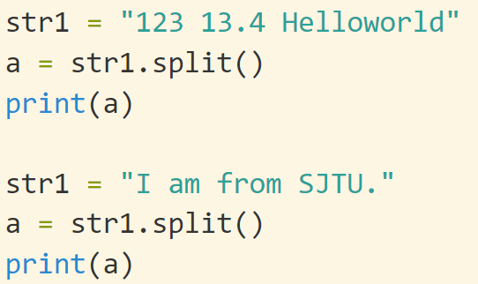
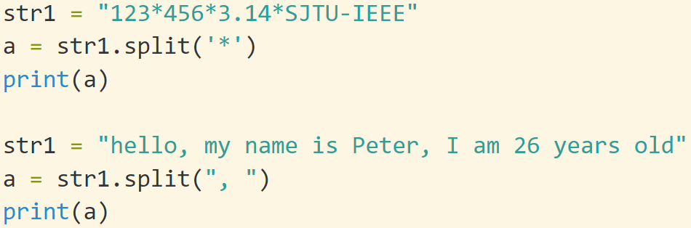
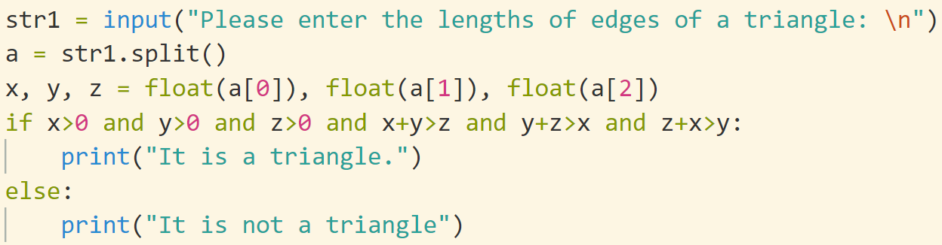

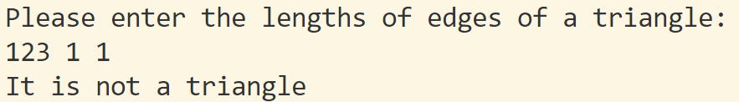
split(): split a string
str.split(): Split a string into a list where each word is a list item:
“I am from SJTU.” → [“I”, “am”, “from”, “SJTU”]
Parameter:
separator: Optional. Specifies the separator to use when splitting the string. By default any whitespace is a separator(默认是空格)
逗号和空格
默认分隔符：空格
自定义分隔符
实际应用

Slide 27








join(): concatenate strings
str.join(): The join function is the inverse of split(). It takes a list of strings and concatenates the elements with a space between each pair
List!
str.join(): could also specify the separator letter
iterable
只连接关键词

Slide 28



str: methods
Python string module provides several built-in functions to process strings
https://docs.python.org/3/library/stdtypes.html
str.find(sub, start, end): Return the lowest index in the string where substring sub is found within the slice s[start:end]. Optional arguments start and end are interpreted as in slice notation. Return -1 if sub is not found.
str.count(sub[, start[, end]]): Return the number of non-overlapping occurrences of substring sub in the range [start, end]. Optional arguments start and end are interpreted as in slice notation.

Slide 29





str: more
str.isdigit(): Return true if all characters in the string are digits and there is at least one character, false otherwise
str.upper(), str.lower(): Return a copy of the string with all the characters converted to upper/lower case
str.strip() method removes any whitespace from the beginning or the end
str.rstrip(), str.lstrip(): Return a copy of the string with tailing/trailing characters removed
str.replace(old, new[, count]): Return a copy of the string with all occurrences of substring old replaced by new
String literals can be processed directly on the content without defining a variable

Slide 30





\t and expandtabs()
\t: tab. How many blanks in print(‘\t’)? It is subtle
\t in Microsoft Office Excel: Jump from one cell to the next
In default, each row of the python console is divided into cells with length equals to 8 spaces
8, 16, 32, …, 8n, …
\t will move the cursor to the beginning the next cell
str.expandtabs(n): set the current tab size to be n(设置tab的大小)
跳到下一个格子
微软office办公文档中，对于每个单元格，有左对齐、右对齐、居中
改变格子长度

Slide 31




str.format()
注意：f-string中的格式化控制符号与str.format()一样，为了演示方便，这里采用了str.format()的方式来编码，推荐优先使用f-string
“I am {} from {}”.format(name, city)
{}: placeholder 占位符
format(): formats the specified value(s) and insert them inside the string's placeholder
The format() method returns the formatted string
You may use index or variable to denote the placeholders
#Accessing arguments by position or name

Slide 32






str.format(): b, o, x
The bin() method converts and returns the binary equivalent string of a given integer
d: 10进制(默认)
b, o, x: 二、八、十六进制
进制转化bin(), oct(), hex(), int(“”, base = 2/8/16)
二进制里有多少个一

Slide 33




Format string
{:format}：Alignment(对齐方式: <, =, >), width(宽度), 小数位
每个单元格，有宽度。所谓宽度(width)为10，就是输出的时候，用当前光标位置后面10个位置来输出数据。有三种情况：
数据长度大于10。默认输出
小于10。左对齐和右对齐（默认右对齐）
等于10。 正常输出即可
对于浮点数，要进一步指明小数点后面的位数。10.3f就是宽度为10，后面保留3位, f表示浮点数
宽度为10，右对齐 >
宽度为10， 左对齐 <
宽度为10，保留三位小数
宽度为5，>右对齐

Slide 34





str.format(): f, d, c, s
f: 浮点数 d: 10进制整数
c: 字符 s: 字符串
单个字符
居中
默认6位小数
https://www.w3schools.com/python/ref_string_format.asp
https://docs.python.org/3.8/library/string.html

Slide 35
str.format(): format types
:< Left aligns the result (within the available space)
:> Right aligns the result (within the available space)
:^ Center aligns the result (within the available space)
:= Places the sign to the left most position
:+ Use a plus sign to indicate if the result is positive or negative
:- Use a minus sign for negative values only
: Use a space to insert an extra space before positive numbers (and a minus sign
before negative numbers)
:, Use a comma as a thousand separator
:_ Use a underscore as a thousand separator
:b Binary format
:c Converts the value into the corresponding unicode character
:d Decimal format

Slide 36
str.format(): format types
:e Scientific format, with a lower case e
:E Scientific format, with an upper case E
:f Fix point number format
:F Fix point number format, in uppercase format (show inf and nan as INF and NAN)
:g General format
:G General format (using a upper case E for scientific notations)
:o Octal format
:x Hex format, lower case
:X Hex format, upper case
:n Number format
:% Percentage format
The Python built-in format() function is similar to the String format method. Internally, both methods call the __format__() method of an object.

Slide 37





f-String: Formatted string literals
Python version ≥ 3.6. 推荐使用
Formatted string literals (also called f-strings for short) let you include the value of Python expressions inside a string by prefixing the string with f or F and writing expressions as {expression}.
f-strings support = for self-documenting expressions and debugging (Py 3.8)
user='eric_idle' member_since=datetime.date(1975, 7, 31)

Slide 38


String module (Not recommended)
Python provides string module, where many useful constants and methods are included
https://docs.python.org/3/library/string.html
To use this module, import string
string.ascii_letters
string.ascii_lowercase
string.ascii_uppercase
string.digits
string.hexdigits
string.octdigits
string.punctuation
string.printable
string.whitespace
string.asci_letters includes all the letters
string.punctuation includes all the punctuation
string.asci_lowercase includes all the lowercase letters
formatter — Generic output formatting: Deprecated since version 3.4: Due to lack of usage, the formatter module has been deprecated.

Slide 39

Set

Slide 40


Set: create
A set is an unordered collection with no duplicate elements.
Basic uses include membership testing and eliminating duplicate entries (重复).
Set objects also support mathematical operations like union, intersection, difference, and symmetric difference.
Curly braces {} or the set() function can be used to create sets.
Note: to create an empty set you have to use set(), not {}; the latter creates an empty dictionary
fruit = {'apple', 'orange', 'pear', 'banana'}
{}: dict
https://docs.python.org/3/tutorial/datastructures.html#sets

Slide 41






set()
The parameter of set() can be type of str, list, dict
List, tuple: all the elements
Dict: all the keywords
String: all the characters
You cannot access items in a set by referring to an index, since sets are unordered the items has no index(不可通过下标访问)
To add one item to a set use the add() method
To add more than one item to a set use the update() method
To remove an item in a set, use the remove(), or the discard() method
The clear() method empties the set
All the above methods can be implemented by basic set operations
数据结构类型
return None: set.add(), set.update()
集合内元素必须是不可修改的，但集合是可以修改的
不能直接加数
把关键字拆开
TypeError: unhashable type: 'list'

Slide 42


Set operations
A|B: Returns a set which is the union of sets A and B （并集）
A& B: Returns a set which is the intersection of sets A and B （交集）
A-B: Returns the set difference of A and B (the elements included in A, but not included in B) （差集）
A^B: Returns the symmetric difference of sets A and B (the elements belonging to either A or B, but not to both sets simultaneously) （并集减交集）
A<=B: Returns true if A is a subset of B （是否蕴含于）
A>=B: Returns true if B is a subset of A
Similar, A<B, A>B
A-B
A^B

Slide 43




删去重复的
Code talks!

Slide 44
Summary

Slide 45
List, tuple, str, dict, set
Mutable: list, dict, set
Immutable: tuple, str
Ordered: list, tuple, str
Unordered: dict, set
Elements of dicts and sets should be immutable. Element of tuples could be immutable
List vs tuple: if we don’t need to alter the elements, tuple is preferred; e.g., return values
Methods of data structures: modified in place or create a new one
List.sort()
range() is not a data structure, but with similar operations
x = range(100)
x[1], x[1: 10: 2]
KISS: Keep It Stupid Simple

Slide 46
List, Dict, Set
 | 3 | 6 | 9 | 12
List is ordered while dict and set are not. List[::] is allowed, which is not legal for dict and set
Insert, alter, delete operation are much faster in set and dict than list
dict vs set: Set is a simplified version of dict.
Elements in dict can be duplicated, Key: values. Dict can used to represent a collection with duplicates while set cannot
If set is enough for your problem, then set should be the choice to keep it as simple as possible.
Set and dict require much more space than list
List 是有序的，而 dict 和 set 不是。List[：：] 是允许的，这对于 dict 和 set 是不合法的
在 set 和 dict 中插入、更改、删除操作比 list 快得多
dict vs set：Set 是 dict 的简化版本。
dict 中的元素可以复制，Key： values。Dict 可用于表示具有重复项的集合，而 set 不能
如果 set 足以解决您的问题，那么 set 应该是使其尽可能简单的选择。
set 和 dict 需要的空间比 list 多得多
大规模查找、插入、修改、删除用dict或者set
顺序访问用list, 列表推导

Slide 47

Loop在编程中的意义
遍历一个集合的元素
根据循环结束时各个变量的状态，判断现在程序的状态，执行下一阶段的命令 (合理利用程序运行中各种信息)
利用循环结束时x的状态，进行下一步操作
计算机的本质在于高速重复
切香肠战术

Slide 48


for x in collection_a: 状态不变
当for开始运行时，x的遍历序列就定义好了
改变x不会改变collection_a
改变x不会改变x的遍历序列
i=0, 1, …, 6不变

Slide 49



Slide 50
for的陷阱: 应对
Code that modifies a collection while iterating over that same collection can be tricky to get right.
for内部的循环机理实现需要定义iter() (高级议题，后面讲到)
尽量不要一边修改集合collection_a, 一边进行for x in collection_a操作
在for x in xxx: do_sth()
do_sth()对x的修改并不改变x的遍历顺序for和range结合的时候也有这种现象
解决思路：
用while 手工操作
用集合collection_a.copy()来处理
用for x in reversed(lst):
列表推导
https://docs.python.org/3/tutorial/controlflow.html#for-statements
https://sopython.com/canon/95/removing-items-from-a-list-while-iterating-over-the-list/

Slide 51


血泪教训：for 和remove尽量不要一起用
特别注意：不要一边修改一个数据结构，一边遍历它，否则遍历的顺序可能会很古怪

Slide 52


+=, /=, *=
In python, when you write an expr like a = a + b, you may just write it as a += b
+=, -=, *=, /=, //=
However, you should pay attention to the situations when a is mutable: list, dict
不可被修改
基本类型：int, float, complex
数据结构: tuple, string
可被修改（在原有基础上修改， id不变）
List, dict, set
自定义复合类型
会重新创建一份，id改变
1941395606080
1941396016256
特别注意区别
创造新变量, 改造旧变量

Slide 53


Mutability of parameters
If a mutable parameter is passed into a function, it may be altered inside the function
a: 基本int类型，不可修改。
b: 是list，可以被修改。
参数传递：
inta = a
listb = b
修改listb就修改了b
讨论：从程序设计的角度而言，你认为参数应该被修改吗？

Slide 54

Built-in functions
The Python interpreter has a number of functions and types built into it that are always available. They are listed here in alphabetical order
Tips: 当你需要实现一个基本的功能的时候，python可能已经帮你实现了
https://docs.python.org/3.8/library/functions.html

Slide 55


sorted: 排序
Python lists have a built-in list.sort() method that modifies the list in-place. There is also a sorted() built-in function that builds a new sorted list from an iterable
sorted(x): 对x排序并return新的list变量
list.sort(): 对列表排序，无返回值
https://docs.python.org/3/howto/sorting.html

Slide 56


zip()
将n个list(tuple, str等等)按元素合并为一个新list: 每个元素都是n维的

Slide 57
eval()
eval可以用来计算一个字符串形式的表达式的值
eval(“123+456”)
返回值是表达式的值
eval完整的功能要强大很多: It is an interesting hack/utility in Python which lets a Python program run Python code within itself
The eval() method parses the expression passed to it and runs python expression(code) within the program.
譬如eval可以将一个字符串形式的list，转换为list
lst = eval(“[1,2,3,[1,2,3]]”)
计算一般的表达式
x= 1 y =2 z=eval(“(x+1)**y+y”)
program = input('Enter a program:')
eval(program) #[print(item) for item in [1, 2, 3]]
Error: eval(“a=1”)
https://www.programiz.com/python-programming/methods/built-in/eval
https://www.geeksforgeeks.org/eval-in-python/

Slide 58


exec()
The exec() method executes the dynamically created program, which is either a string or a code object
Return none （执行字符串表示的代码）
program = input('Enter a program:’)
exec(program) #[print(item) for item in [1, 2, 3]]
https://www.programiz.com/python-programming/methods/built-in/exec
https://stackoverflow.com/questions/2220699/whats-the-difference-between-eval-exec-and-compile

